Slide 1


Smart Data Analytics Challenge 2018

Slide 2

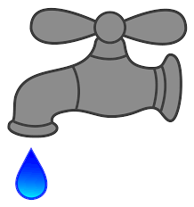
Problems Solved
Regis Waterlytics Company: Water Data Analysis
Our team worked on two areas of analysis:
1. Population Study
We projected water usage based on population growth to help stakeholders scale water distribution for the future.
2. Leak Study
We sought to answer these questions:
How do cities rank in water loss?
Are there factors that have linear relationships with water loss that should be more closely monitored by stakeholders?
Is the data structured correctly to help us best answer these questions?
We’ll go through one study at a time in these slides.
First Up: Water Use Projections for Population Growth
2018 Submission Template

Slide 3
2a. Impact – Population Study
The purpose of this study is to explore the HB 1051 data with an
emphasis on population projections and water production projections.
Colorado’s population is projected to grow and water reserves are projected to become more scarce based on climate change.
We hope to help the water districts prepare for growing populations.
2018 Submission Template

Slide 4
3a. Methodology – Population Study
To analyze population and water production projections:
Files were merged to create datasets with population and water production in one place, separated by water type (e.g., potable, non-potable raw, and non-potable reuse).
We created population projections by city/county through the year 2050.
A linear model was fit to potable water production based on population served.
We can anticipate required potable water production per county through 2050 using the population projections.
2018 Submission Template

Slide 5
4a. The Data – Population Study
The data can be found at http://cowaterefficiency.com/unauthenticated_home with permission. Once in the portal, all report years (2013-2017) were selected as well as all water providers.
This report uses the following datasets:
overview.csv
normalizing_03_population.csv
water_use_02_production.csv
Historical Census Data at https://demography.dola.colorado.gov/population/data/historical_census/
2018 Submission Template

Slide 6
5a. Feasibility – Population Study
The analysis is complete but could be improved or expanded in these key ways:
If datasets included a breakdown of how much water each county uses when multiple counties share a single water supplier, projections could be adapted to show projected percent increase/decrease in necessary water production rather than simply providing raw numbers.
If the datasets included a breakdown of amount of water used by customer category, it would allow for more accurate projections and would allow for further analysis in regards to usage by customer category. Currently, customer categories served per report are present in the normalizing_04_svcconn_setup.csv file, but have no indication of the division of water amongst these customers (residential, commercial, irrigation, utility, etc.).
2020 census data will help improve the population growth projection aspect of this model. Historical-census-data-counties.csv and historical-census-data-municipalities.csv data should be obtained from https://demography.dola.colorado.gov/population/data/historical_census/ when this is available and the analyses can be re-run.
2018 Submission Template

Slide 7
6a. Results – Population Study
Many counties and municipalities will need to scale up potable water production in order to serve expanding populations.
Some counties and municipalities are projected to see a decline in population growth.
Area for further research: Could water production from declining areas be diverted to areas that are continuing to grow (infrastructure and proximity permitting)?
2018 Submission Template

Slide 8
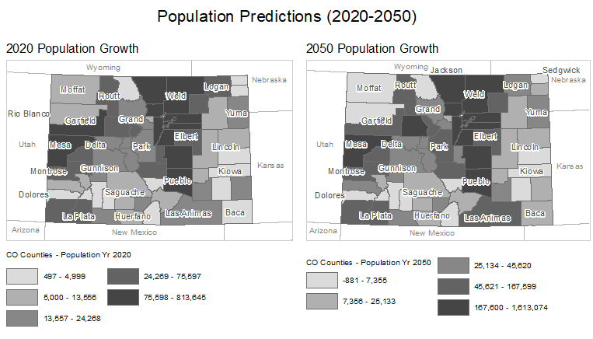
6a. Results – Population Study
Many counties will experience growth in the next 30 years

Slide 9
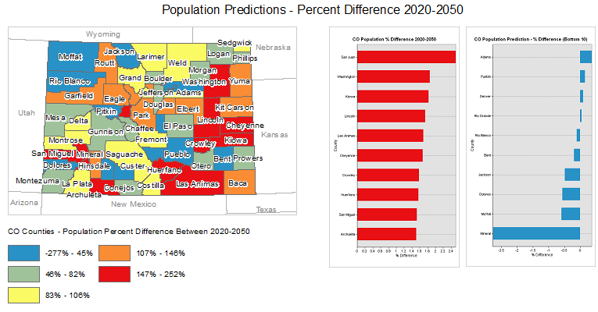
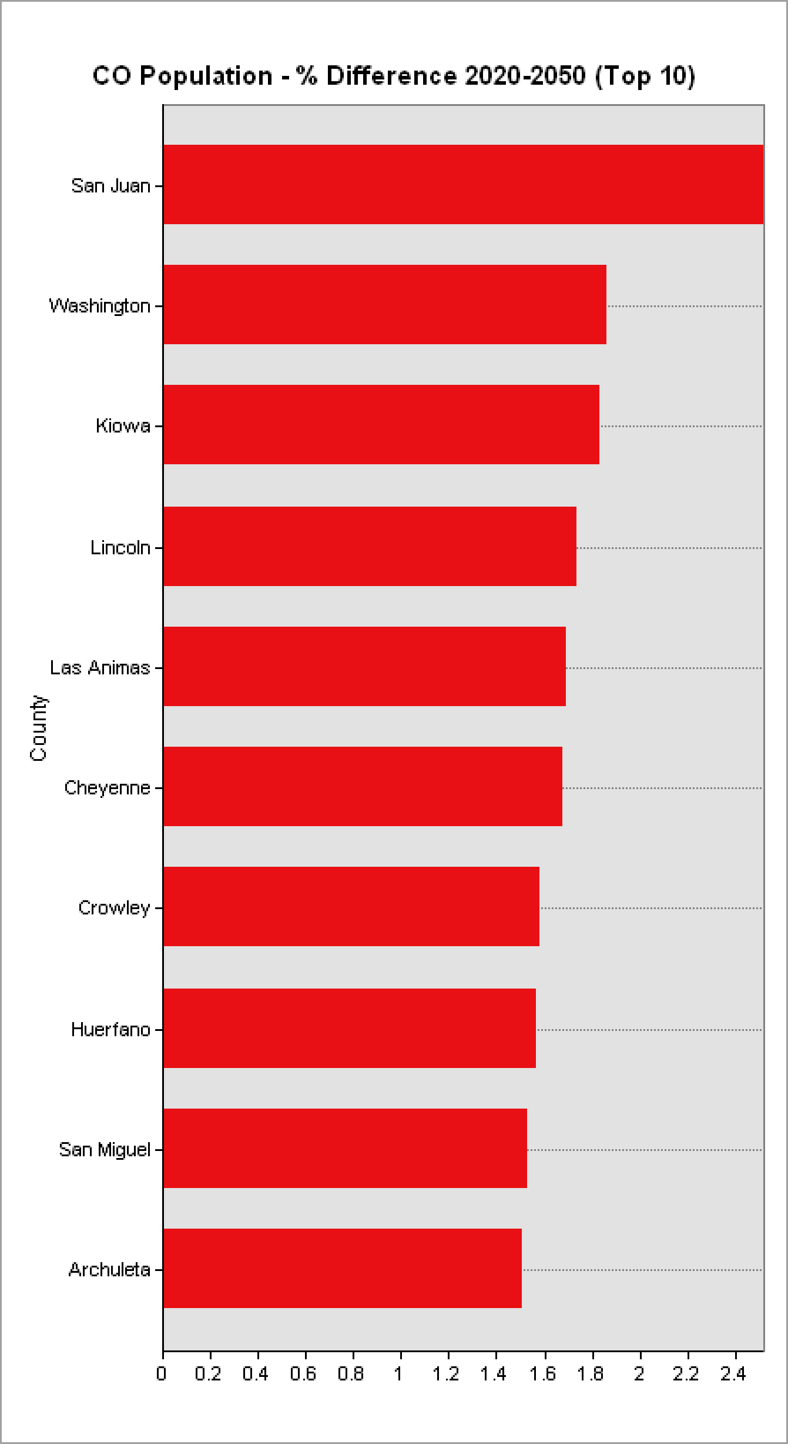
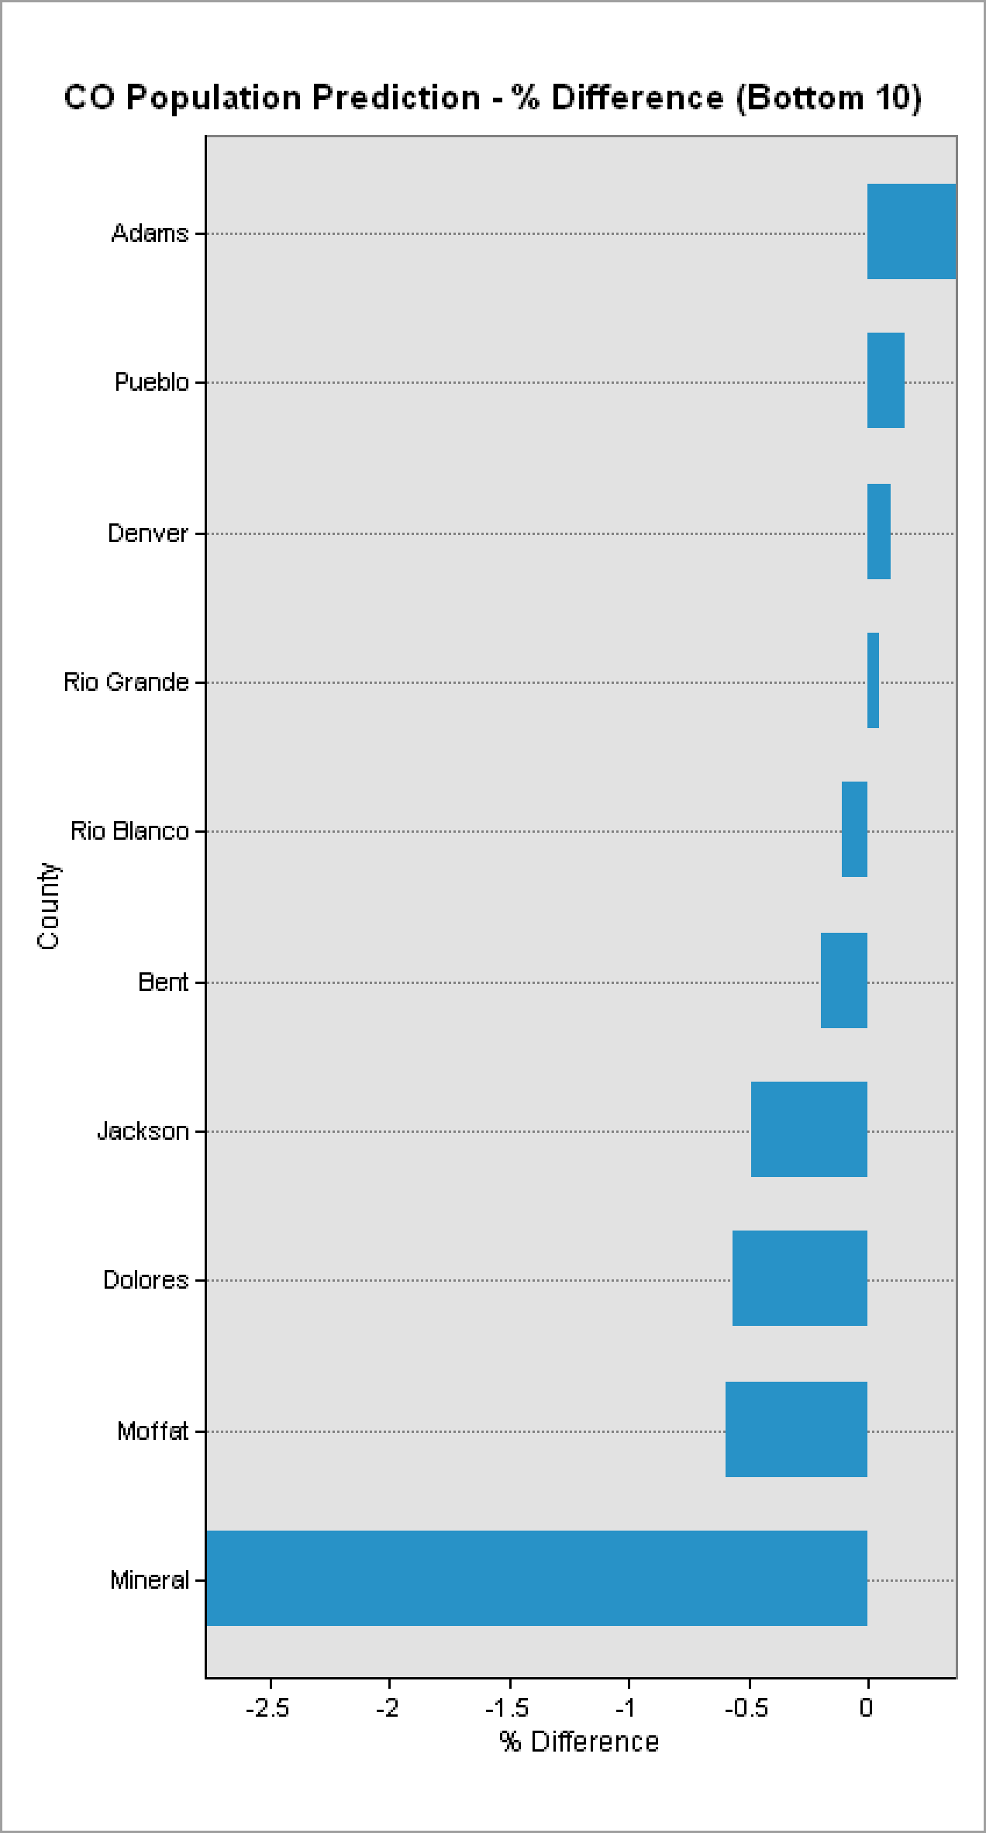
6a. Results – Population Study
San Juan will have the largest % difference in population predictions.
Mineral will have the small % difference in population predictions.

Slide 10
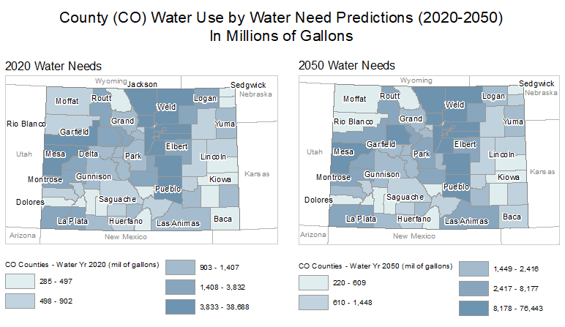
6a. Results – Population Study
Water needs will continue to grow across the state by 2050.

Slide 11
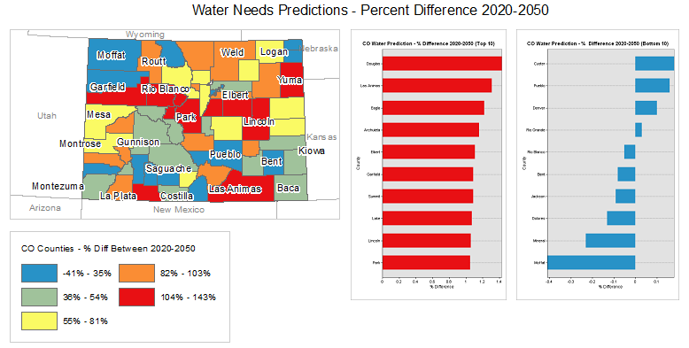
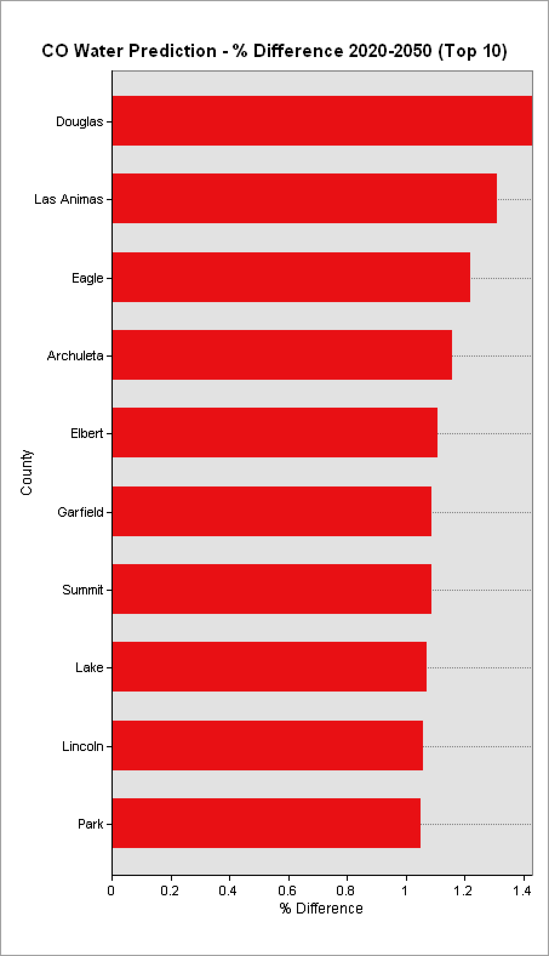
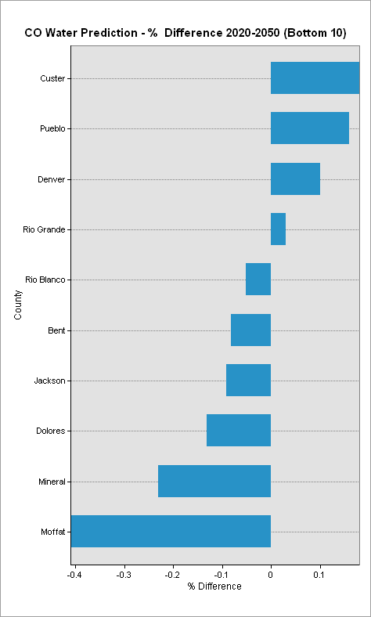
6a. Results – Population Study
Douglas County will have the largest % difference in water needs.
Moffat County will have the smallest % difference in water needs.

Slide 12
2b. Impact – Leak Study
Mitigating water loss (leaks) is important. Monitoring and reducing leaks is
critical as Colorado’s population grows, water becomes more scarce, and climate change affects our environment.
We sought to:
Rank cities/water providers based on water loss to help those districts understand whether they are doing a good job in two areas: reporting their information and/or limiting leaks.
Find correlations between leaks and other factors to help districts better identify and prevent leaks.
Determine the most common types of water leak detection technologies being used as determined through text analysis.

Slide 13
3b. Methodology – Leak Study
We analyzed water loss by percent (rather than convert units of water measure), where Percent Loss per Provider = [1 - (Metered Water/Distributed Water)] * 100
Our analysis included:
Merging files to create datasets with provider, percent water loss, and leak detection methods or other related variables in one place. These variables included meter monitoring and replacement, pipe inspection and replacement, and AWWA policy compliance.
Multiple linear regression and the Wilcoxon Rank-Sum test to look for relationships between variables.
N-grams to conduct text analysis on the leak detection comments field and make recommendations for reporting.
2018 Submission Template

Slide 14
4b. The Data – Leak Study
The data can be found at http://cowaterefficiency.com/unauthenticated_home with permission. Once in the portal, all report years (2013-2017) were selected as well as all water providers.
For leak analysis, we used the following datasets:
Foundational_06a_loss_and_leak_det.csv
Foundational_06b_leak_det_types.csv
Foundational_08_audit_data.csv
Foundational_09_balance_data.csv
Overview.csv
2018 Submission Template

Slide 15
5b. Feasibility – Leak Study
Our most important suggestions apply to the structure of the data itself, which raises certain questions:
How is it possible to have negative water loss, where there is more metered water reported than distributed water? Is negative water loss accurate under any circumstances, or is it simply erroneous reporting? If erroneous, we suggest programming a flag to warn of this during data input or make it impossible to enter more metered than distributed water, or impossible to enter 0 for either. Empty values in one or the other field causes nonsensical outliers, most likely reporting errors.
If negative water loss is accurate under certain circumstances (although we can’t imagine what those would be), please revise the data dictionary to explain these circumstances.
We recommend using drop-down menus to enter leak detection technology, such as colorimeters, aqua scopes, third party services, correlators, etc. regarding the leak_detection_comments field in Foundational_06a_loss_and_leak_det.csv. Listing standard language and technology would allow us to further analyze their effectiveness and relationships.
The feasibility of implementing these recommendations lies with where the data resides (Excel templates? database or databases?) and what resources would be available to edit some of the fields.

Slide 16
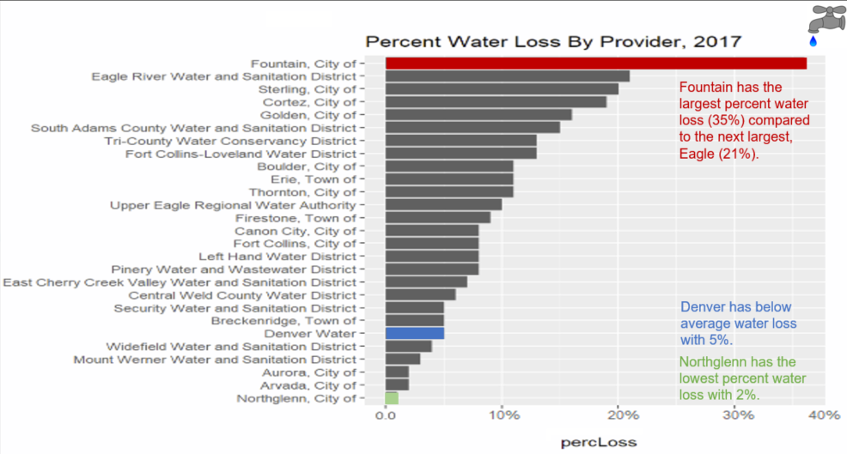

6b. Results – Leak Study

Slide 17
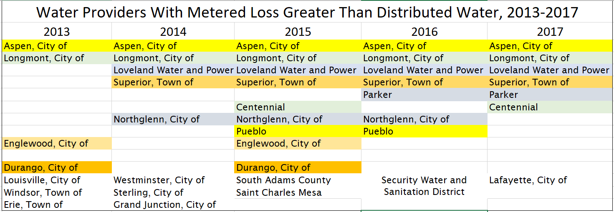
6b. Results – Leak Study
Water Providers with Negative Water Loss: Reporting Errors?
2018 Submission Template

Slide 18
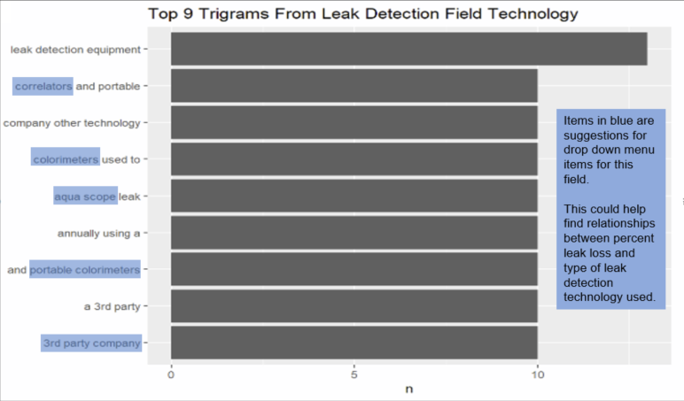
6b. Results – Leak Study
We found the most used word combinations in the leak detection comments field as
determined by text analysis.
2018 Submission Template

Slide 19
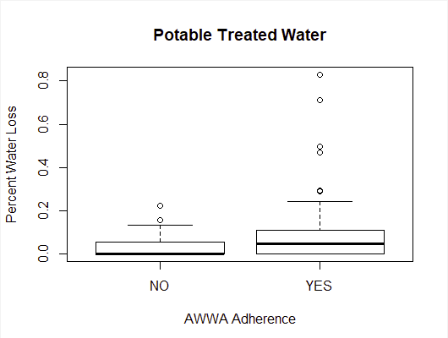
6b. Results – Leak Study
Correlations:
Once the data was cleaned for outliers, a Wilcoxon Rank-Sum test was performed on percent water loss versus providers that were AWWA-policy compliant on their potable treated water. We found that providers that were AWWA-policy compliant had a significantly higher percent water loss than providers that were not AWWA-policy compliant. A Wilcoxon Rank-Sum test showed no significant difference in water loss between reported leak detection types (active field testing, active accounting testing, reactive testing, etc.)
2018 Submission Template

Slide 20
6b. Results – Leak Study
Correlations:
In running multiple linear regression, we found weak correlations between percent water loss and the percent of systems inspected for leaks annually and the age at which the provider replaces small meters.
We found no correlation between the other variables:
Percent of pipes replaced annually
Number of years between large meter testing
Whether the provider had implemented a meter testing program).
2018 Submission Template

Slide 21
Acknowledgements
Thank you for this opportunity to learn and serve the great state of Colorado.
Thank you to Regis University for bringing our team together and to Professor Kellen Sorauf for advising our team.
Presentation prepared by:
Cynthia Mann David Sciacca
Lolita Mannik Kat Bardash
Kellen Sorauf, Ph.D.
2018 Submission Template

Slide 22
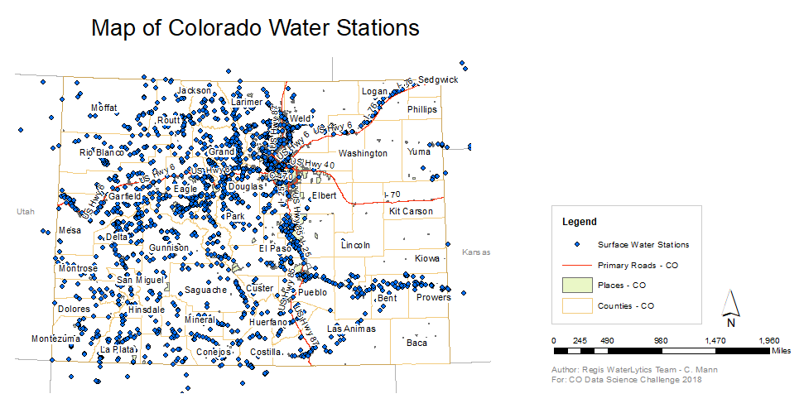
Appendix

Slide 23
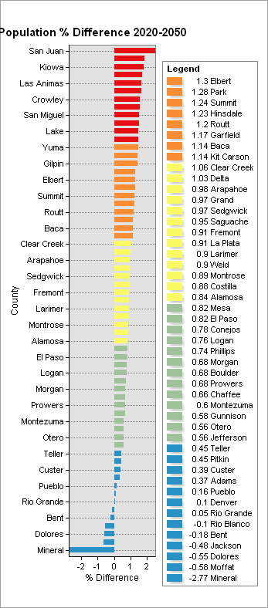
Appendix
Projected Population Changes by % (County)

Slide 24
Smart Data Analytics Challenge 2018

